Slide 1
Danger Alert!! -To prevent and control accidents
-By Debasis

Slide 2
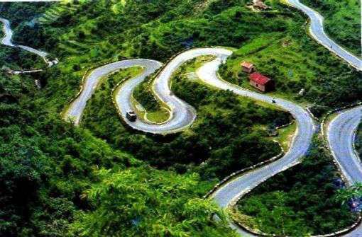
Agenda
Problems on hairpin bend roads.
Statistics of the road accident on these areas.
Solution to this problem.
Public survey.
Advantages of this device.
Question and answers.

Slide 3
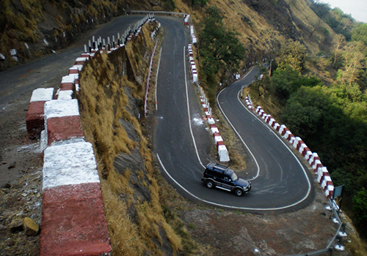
Problems on hairpin bend roads
“Deadliest of all the turns of death”.
People are unaware of what is coming from other side.
Increase of accidents.
Increase of death rate in these areas.

Slide 4
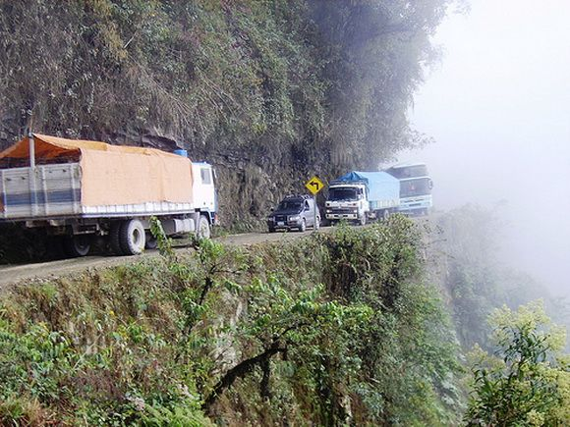
Statistics of these accidents
The report shows that
75 % of road accidents
and death happens
while vehicle crosses
a hairpin bend roads.

Slide 5
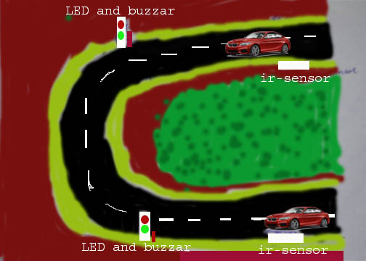
Solution to these problems
Humans instinctively react to
sounds.
Use of smart technologies such
as long range distance sensors,
LED lights, Buzzers, Radar speed detection .
This would alert both the
vehicles if they are coming
from the opposite side.

Slide 6
Advantages of this device
Reduces the occurrence of accidents.
Saves the life of people.
Moderate cost to implement.
Improves safety of the people.

Slide 7
Public Survey
Sharath(Private employee) -
Krishna(Bus driver)
It is good idea about safety of the people in hilly areas.
It will be very useful device.

Slide 8


